Slide 1
API Economy (oh yea – and what’s this JSON all about?)
June 20, 2019

Slide 2


Full stack environment
A couple of the components
API
BROWSER
HTML/CSS/JS
Server (Back-End)
Node.js, Python, C#, Java
HTTP Request
USER
HTTP Response with JSON
MongoDB
Database
API response
Road to Hire

Slide 3
WHAT IS AN API?

Slide 4
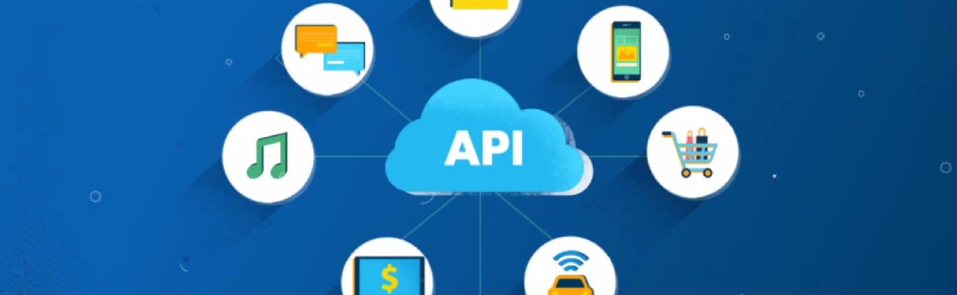
An application programming interface (API) is a set of features and rules that exist inside a software program (the application) enabling interaction with it through software—as opposed to a human user interface.
— MDN Web Docs, developer.mozilla.org

Slide 5
Common use case
Functions for data
Functions for other functions
Functions to control devices
Weather data
Star wars data
Move data
Credit Card Authorization
Google maps
Spotify tools
Nest
Airplane engines
Self driving cars

Slide 6

Airbnb uses Google Maps API to help customers identify locations of properties they may want to rent
Airbnb website

Slide 7
WHAT IS JSON?

Slide 8

JSON is an acronym and means JavaScript Object Notation. JSON is an object and is used as a data interchange format.

Slide 9
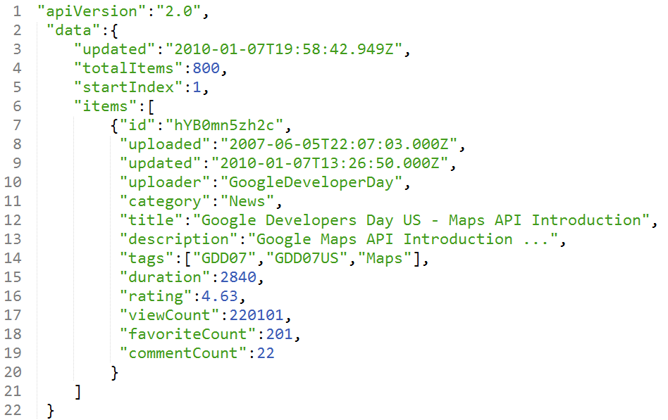
JSON is a lightweight data interchange format used to correlate keys with values.
Array
Object
Key or Property
Value

Slide 10
TIME FOR A POLL!!
https://pollev.com/patrickhowar106

Slide 11
We’re software engineers! We can figure this out!!
Let’s tap into APIs to help
Download postman on your laptop
https://www.getpostman.com/
Open up postman and follow my lead from the screen to enter and trigger an API
We’ll discuss the results once everyone succeeds with this operation

Slide 12
Use Postman to trigger an API ‘get’
https://swapi.co/api/people/1

Slide 13
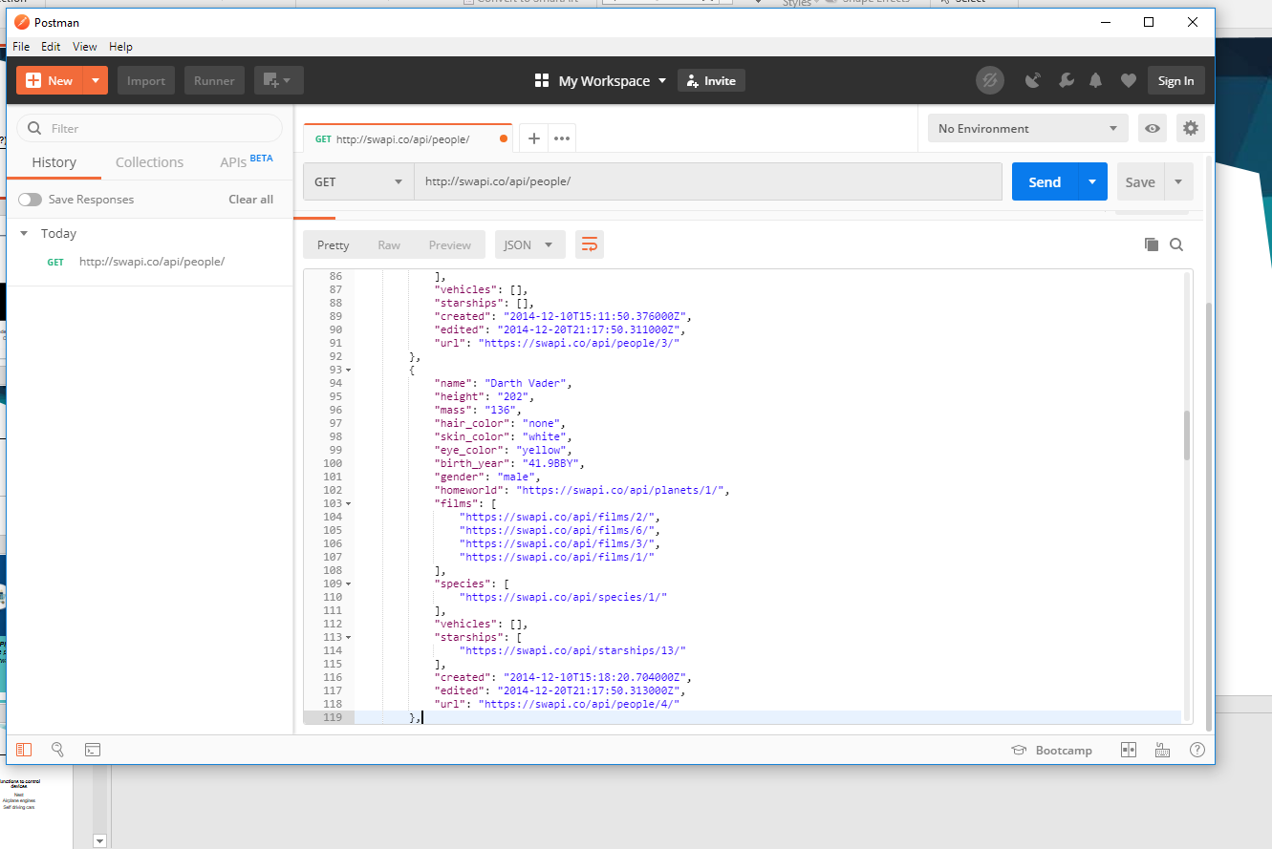
202 inches! Or over 16 feet

Slide 14
Lets Live Code!!
And learn a little more about objects

Slide 15

www.roadtohire.org

